Slide 1
Chapter 6 Functions of Combinational Logic

Slide 2
Half, Full Adder & Parallel Adder

Slide 3
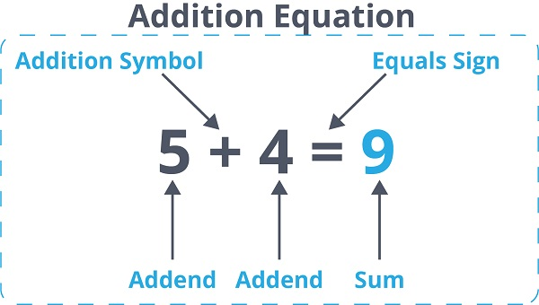
Simple Addition

Slide 4
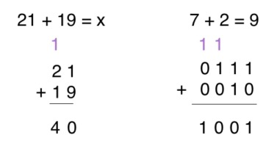
Binary Addition

Slide 5
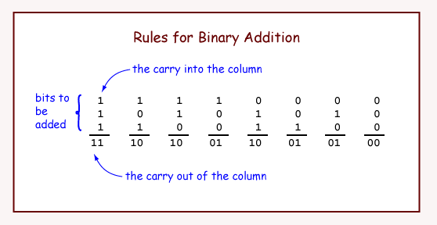

Slide 6
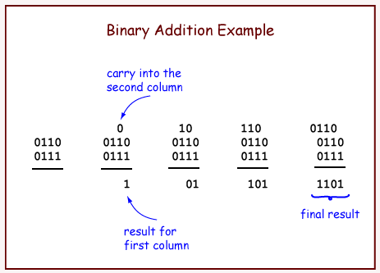

Slide 7
Adder Introduction
An adder is a digital logic circuit in electronics that implements addition of numbers. In many computers and other types of processors, adders are used to calculate addresses, similar operations and table indices in the ALU and also in other parts of the processors. These can be built for many numerical representations like excess-3 or binary coded decimal.

Slide 8
Adders Are Classified Into Two Types
Half Adder and Full Adder.
The half adder circuit has two inputs: A and B.
It add two input digits and generate a carry and sum.
The full adder circuit has three inputs: A, B and C.
It add the three input numbers and generate a carry and sum

Slide 9
Half Adder
Using Half Adder, you can design simple addition with the help of logic gates.
Let’s see an addition of single bits.
0+0 = 0
0+1 = 1
1+0 = 1
1+1 = 10

Slide 10
Half Adder
These are the least possible single-bit combinations. But the result for 1+1 is 10, the sum result must be re-written as a 2-bit output. Thus, the equations can be written as 0+0 = 00
0+1 = 01
1+0 = 01
1+1 = 10
The output ‘1’of ‘10’ is carry-out. ‘SUM’ is the normal output and ‘CARRY’ is the carry-out.

Slide 11
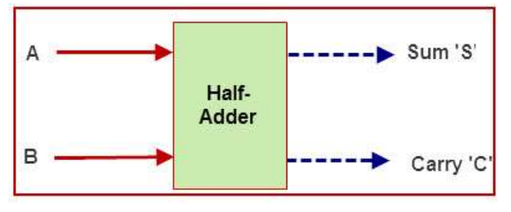
Half Adder

Slide 12
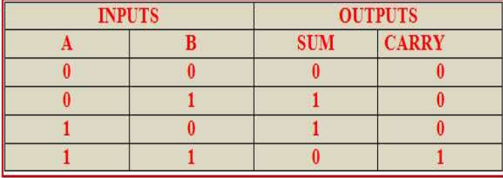
Half Adder Truth Table

Slide 13
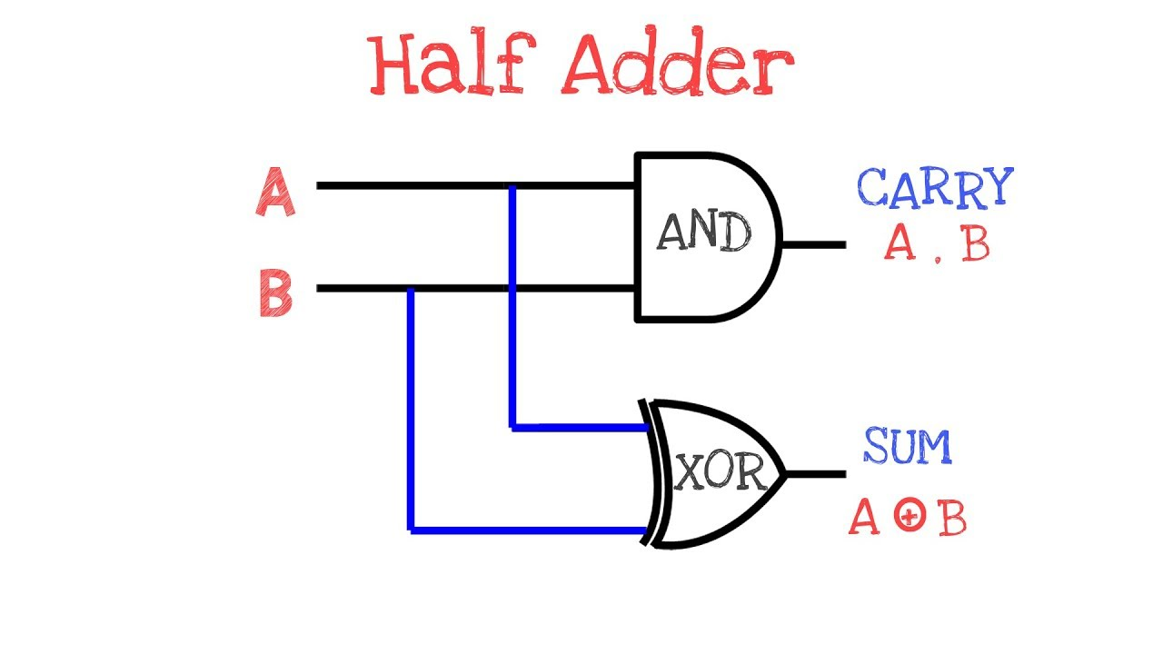
Half Adder Expression

Slide 14
What is Half Adder Circuit
The half adder adds two binary digits called as augend and addend.
Half adder produces two outputs as sum and carry.
XOR is applied to both inputs to produce sum.
AND gate is applied to both inputs to produce carry.

Slide 15
Full Adder
The difference between a half-adder and a full-adder is that the full-adder has three inputs and two outputs.
Whereas half adder has only two inputs and two outputs.
The first two inputs are A and B and the third input is an input carry as CIN.
When a full-adder logic is designed, you string eight of them together to create a byte-wide adder and cascade the carry bit from one adder to the next.

Slide 16
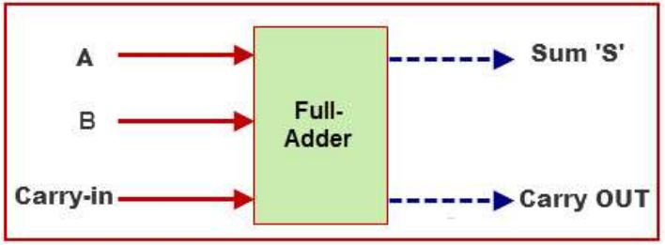
Full Adder

Slide 17
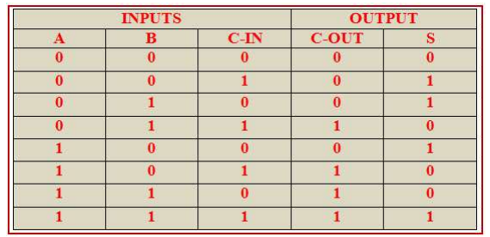
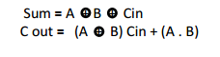
Full Adder Truth Table

Slide 18
Full Adder Truth Table
The full adder logic can be implemented with the truth table.
The output S is an XOR between the input A and the half-adder, SUM output with B and C-IN inputs.
Take C-OUT will only be true if any of the two inputs out of the three are HIGH.

Slide 19
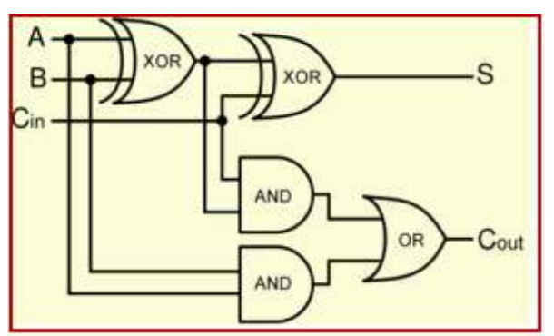
Full Adder Logic Circuit

Slide 20
What Is Full Adder Circuit
The full adder adds 3 one bit numbers.
Where two can be referred to as operands.
One can be referred to as bit carried in.
It produces 2-bit output, and these can be referred to as output carry and sum.

Slide 21
Full Adder Logic Circuit
We can implement a full adder circuit with the help of two half adder circuits.
First, half adder will be used to add A and B to produce a partial Sum.
A second half adder logic can be used to add C-IN to the Sum produced by the first half adder to get the final S output.
If any of the half adder logic produces a carry, there will be an output carry.

Slide 22
Full Adder Logic Circuit
We can implement a full adder circuit with the help of two half adder circuits.
First, half adder will be used to add A and B to produce a partial Sum.
A second half adder logic can be used to add C-IN to the Sum produced by the first half adder to get the final S output.
If any of the half adder logic produces a carry, there will be an output carry.

Slide 23
Full Adder Logic Circuit
A C-OUT will be an OR function of the half-adder Carry outputs.
The implementation of larger logic diagrams is possible with full adder logic.

Slide 24
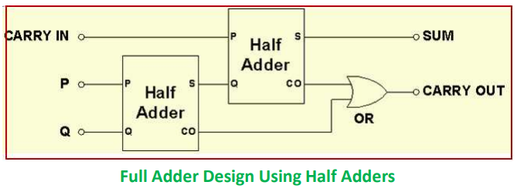
Making Full Adder Using Half Adder

Slide 25
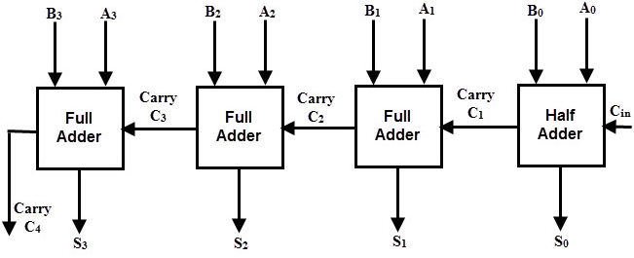
Parallel Adder

Slide 26
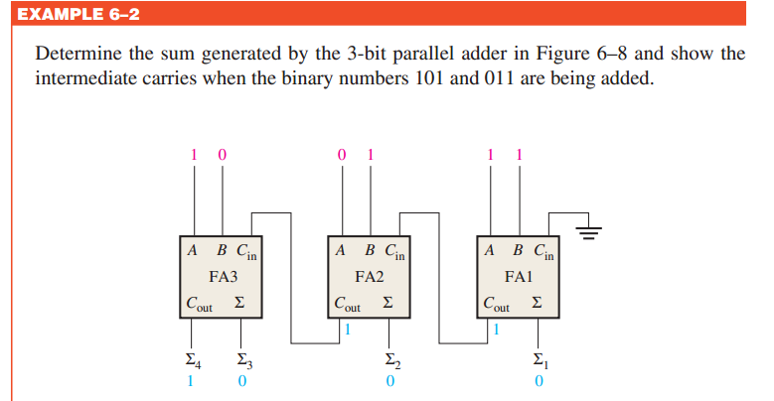

Slide 27
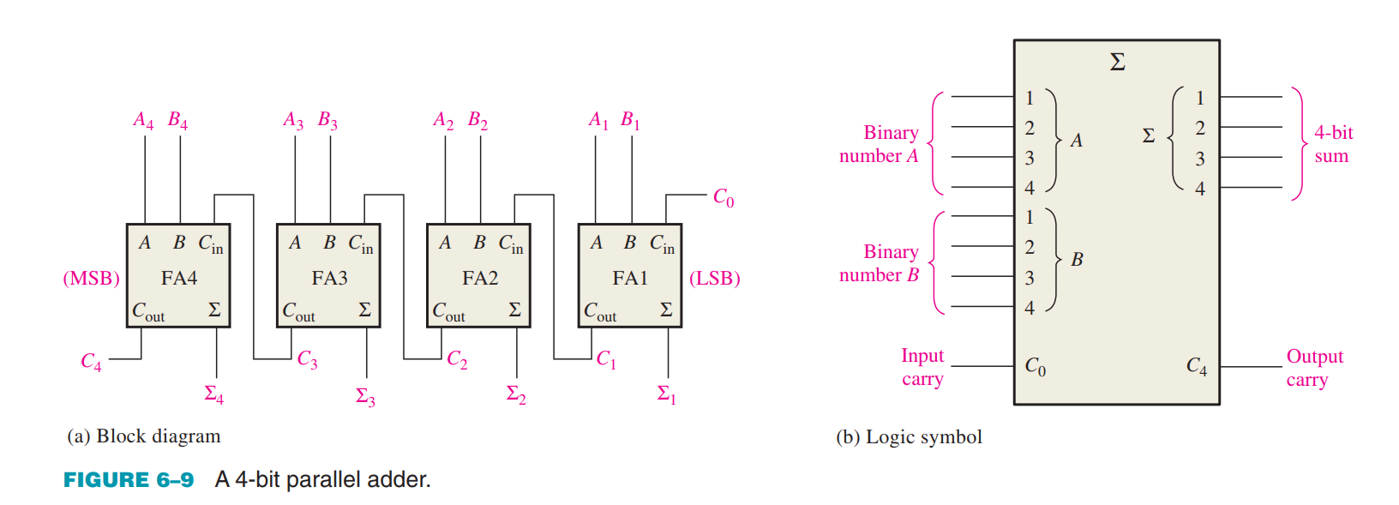
Four-Bit Parallel Adders

Slide 28
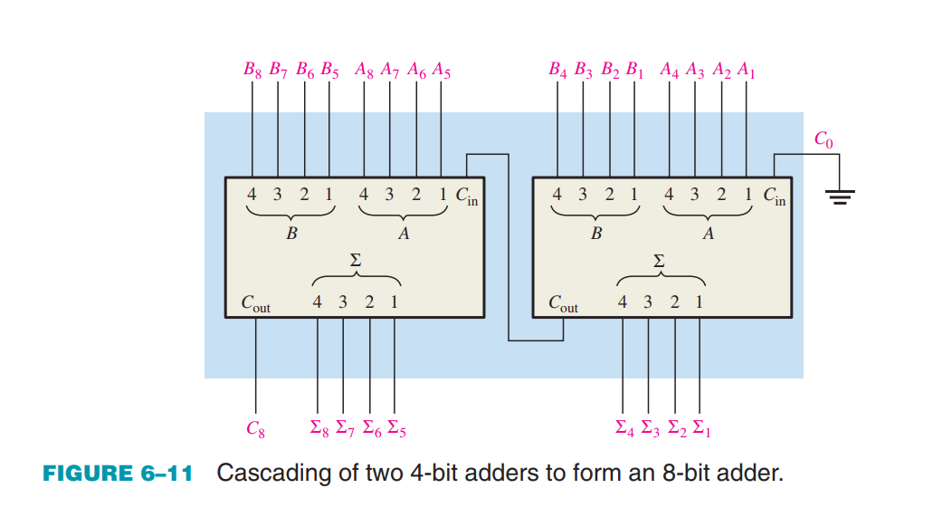
Adder Expansion: Constructing 8 bit Adder using 4 bit Adder IC

Slide 29
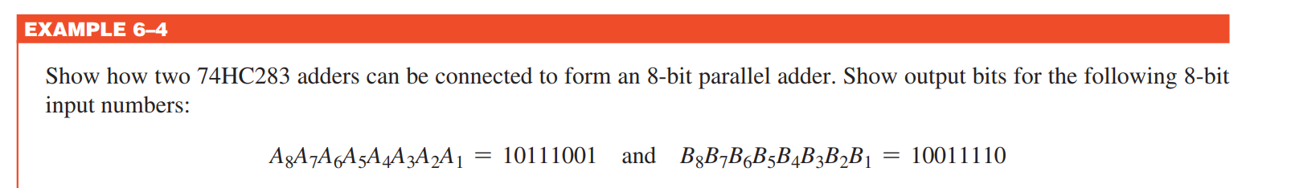
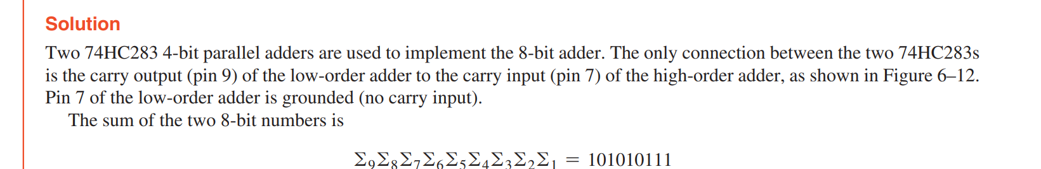

Slide 30
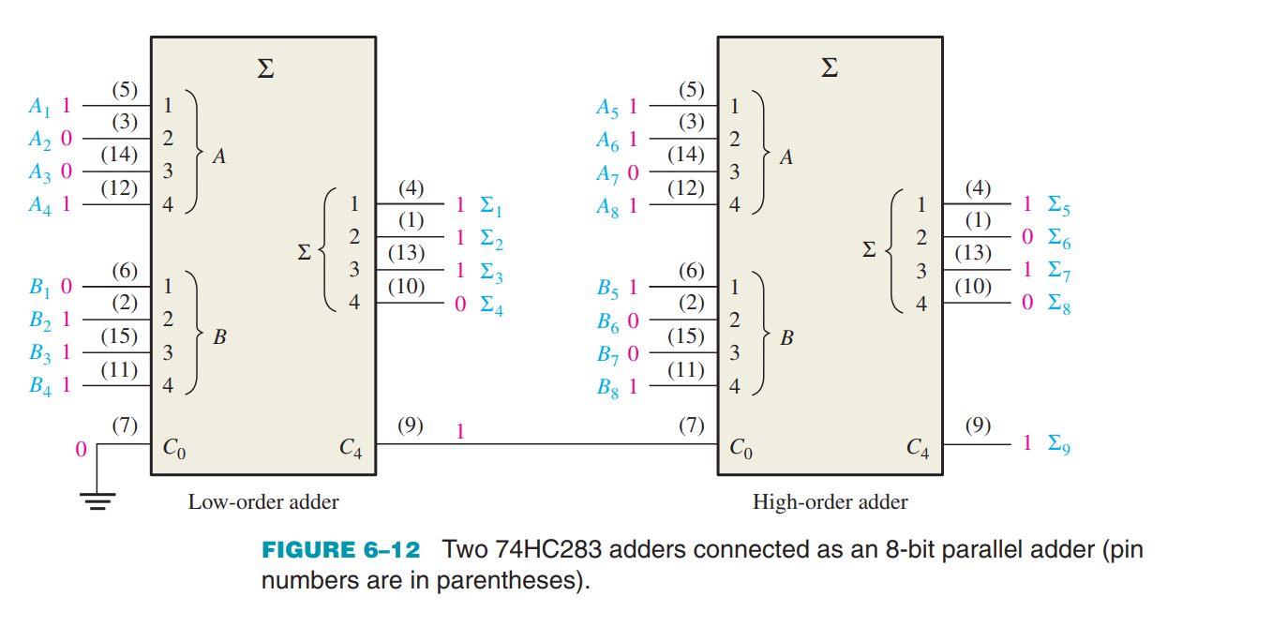

Slide 31
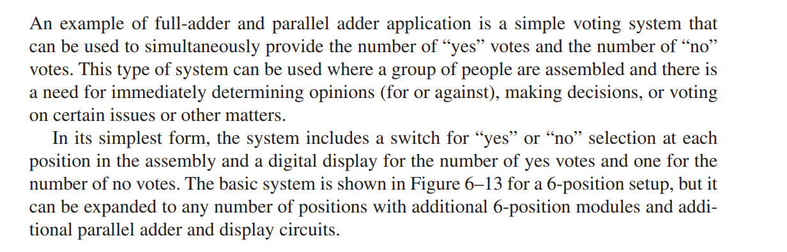
Adder Application (Voting Machine)

Slide 32
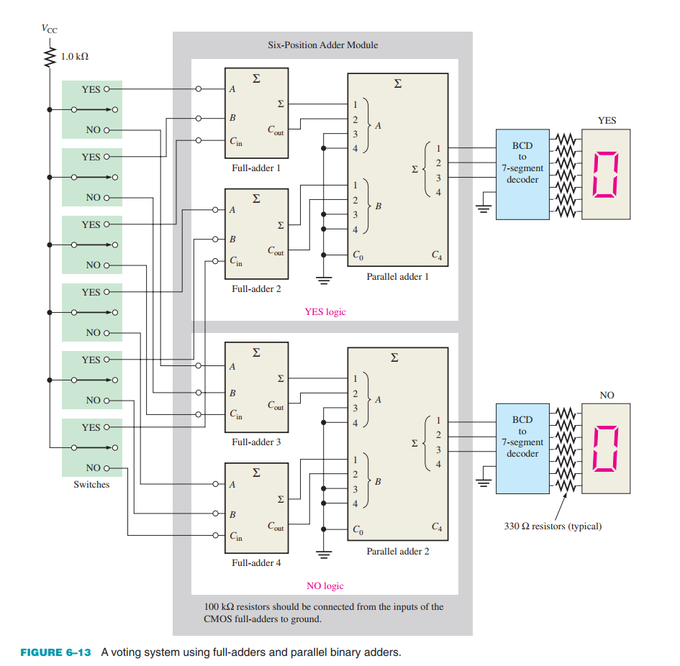

Slide 33
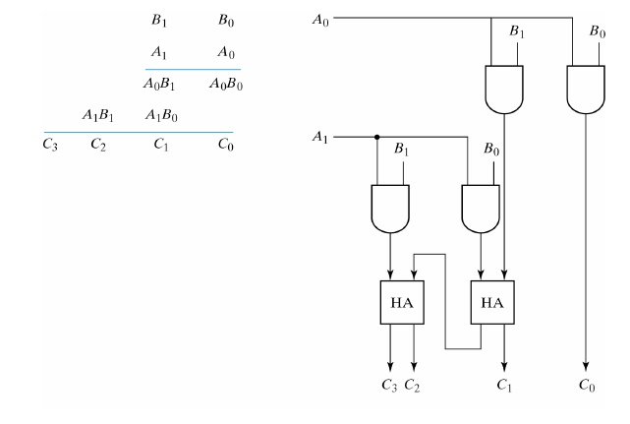
2 Bit Multiplier

Slide 34
Design 3 Bit & 4 Bit Multiplier

Slide 35
Comparator

Slide 36
MAGNITUDE COMPARATOR: DIGITAL COMPARATOR
It is a combinational logic circuit.
Digital Comparator is used to compare the value of two binary digits.
There are two types of digital comparator
(i) Identity Comparator
(ii) Magnitude Comparator.

Slide 37
IDENTITY COMPARATOR: This comparator has only one output terminal for when A=B, either A=B=1 (High) or A=B=0 (Low)
MAGNITUDE COMPARATOR: This Comparator has three output terminals namely A>B, A=B, A<B. Depending on the result of comparison, one of the output will be High (1).
Block Diagram of Magnitude Comparator is shown in Fig. 1

Slide 38
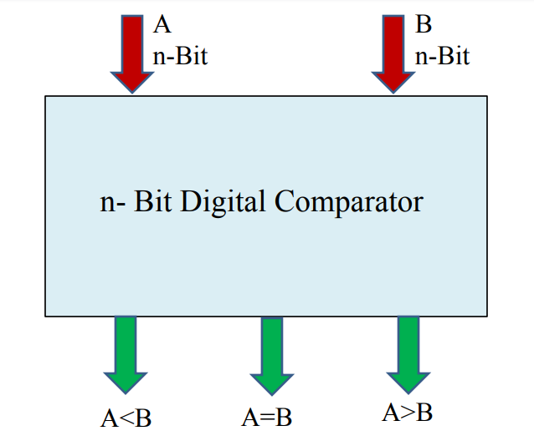
BLOCK DIAGRAM OF MAGNITUDE COMPARATOR

Slide 39
1- Bit Magnitude Comparator
This magnitude comparator has two inputs A and B and three outputs AB.
This magnitude comparator compares the two numbers of single bits.
Truth Table of 1-Bit Comparator

Slide 40
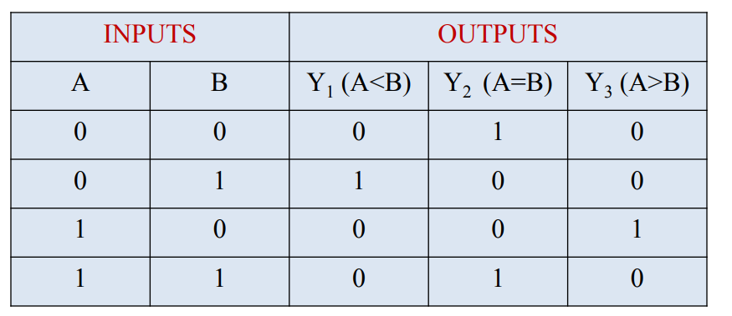

Slide 41
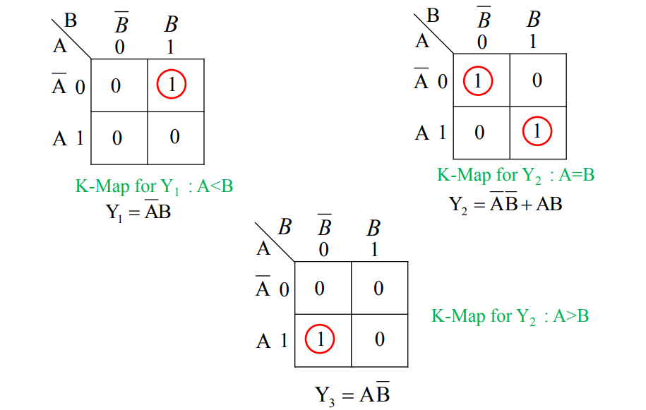
K-Maps For All Three Outputs

Slide 42
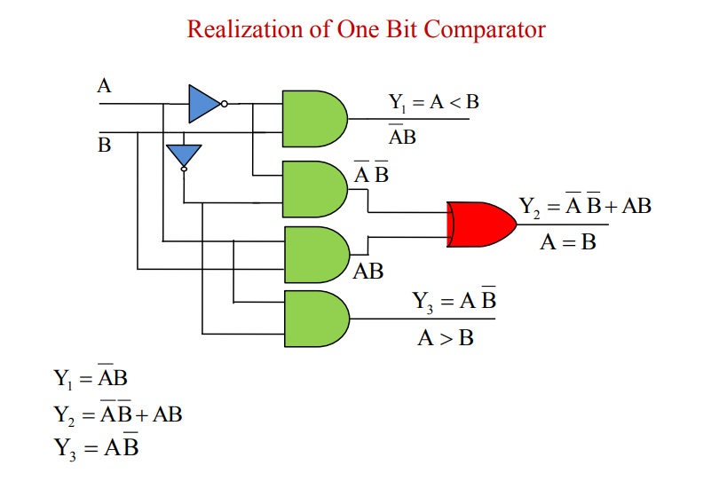

Slide 43
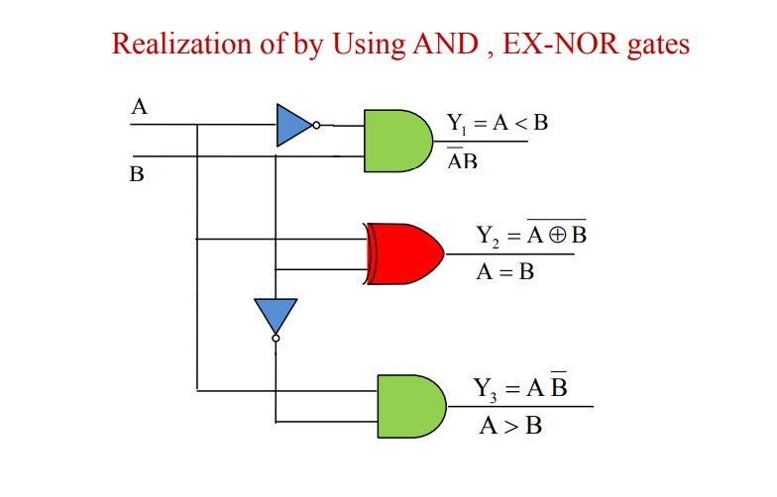

Slide 44
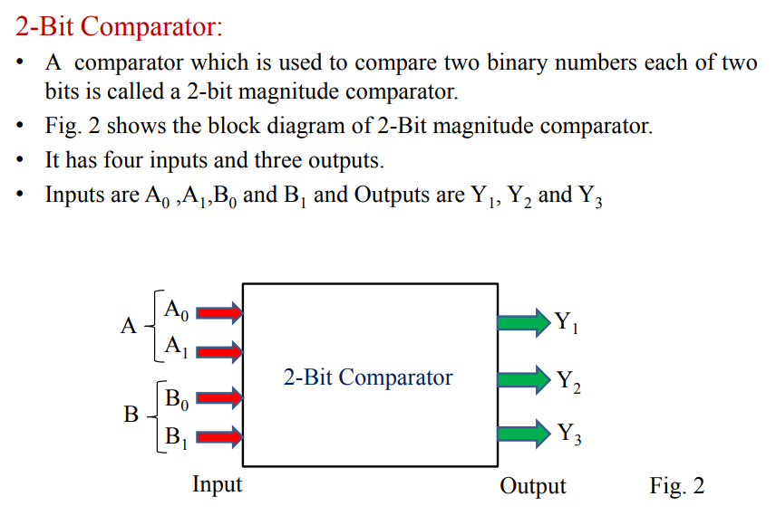

Slide 45
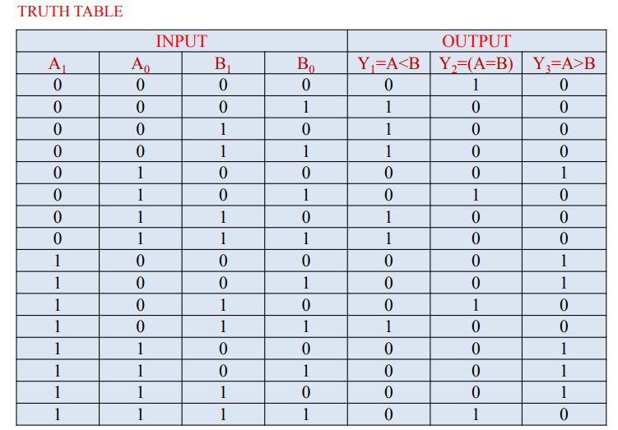

Slide 46
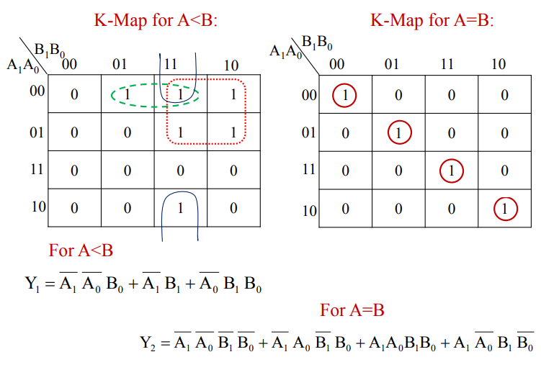

Slide 47
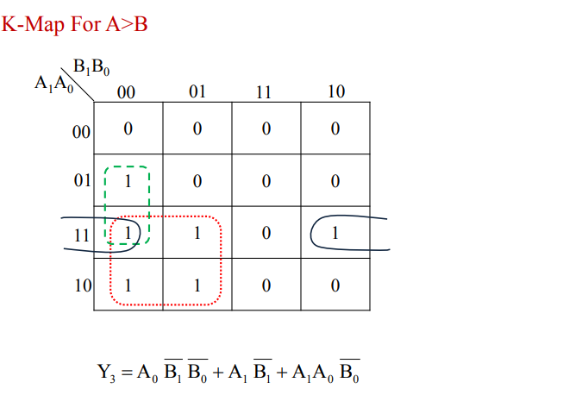

Slide 48
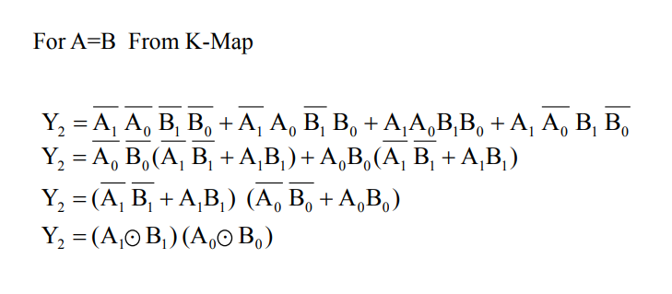

Slide 49
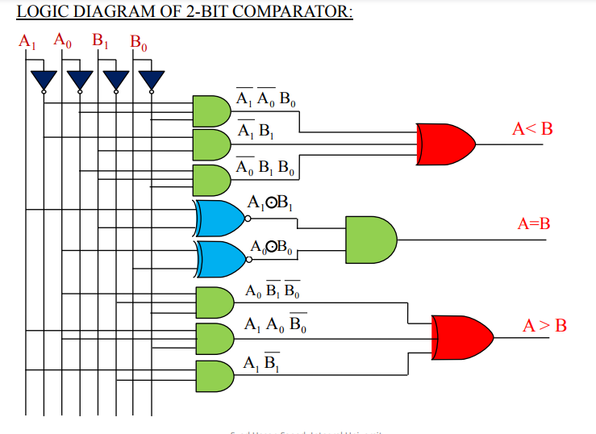

Slide 50
3-bit Comparator
To design 3-bit comparator.
Number of inputs 6 A2,A1,A0, B2,B1,B0
Total number of combination 2^6=64
Huge truth table then K-map so traditional method is complex.
We need another approach to design a comparator circuit.

Slide 51
Designing general equation for comparator.
In this example we are comparing 3 bits two inputs.
A2 & B2 are MSB. A0 & B0 are LSB.
It compares each of these bits in one number with bits in that of other number and produces one of the following outputs as A = B, A < B and A>B. The output logic statements of this converter are

Slide 52
If A2 = 1 and B2 = 0, then A is greater than B (A>B). Or
If A1 and B2 are equal, and if A1 = 1 and B1 = 0, then A > B. Or
If A2 and B2 are equal & A1 and B1 are equal, and if A0 = 1, and B0 = 0, then A>B. Or

Slide 53
Equation
A>B = A2B2’ + (A2 Ex-Nor B2)A1B1’ + (A2 Ex-Nor B2)(A1 Ex-Nor B1)A0B0’
A<B = A2’B2 + (A2 Ex-Nor B2)A1’B1 + (A2 Ex-Nor B2)(A1 Ex-Nor B1)A0’B0
A=B =(A2 Ex-NOR B2) (A1 Ex-NOR B1) (A0 Ex-NOR B0)

Slide 54
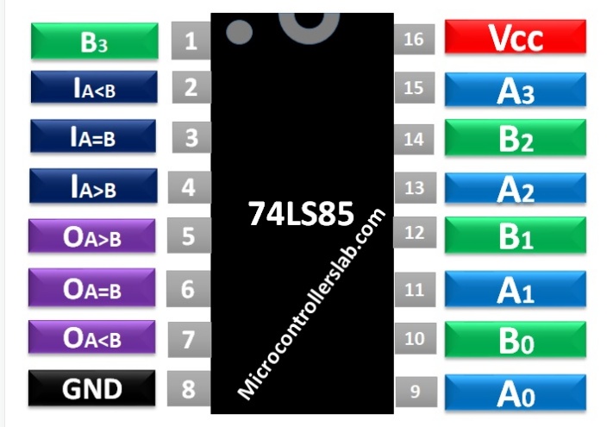
4-Bit Comparator IC

Slide 55
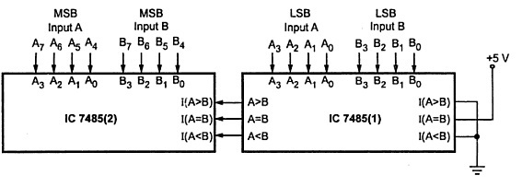
8-Bit Comparator

Slide 56
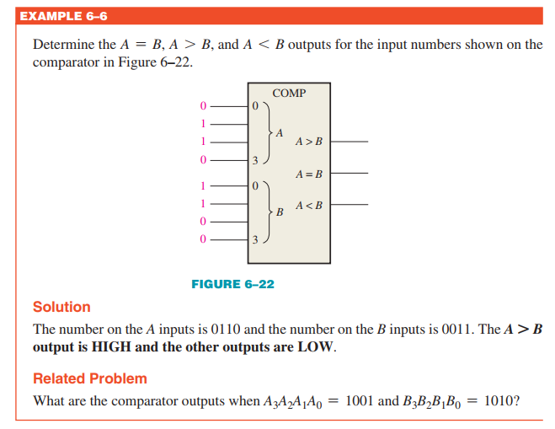

Slide 57
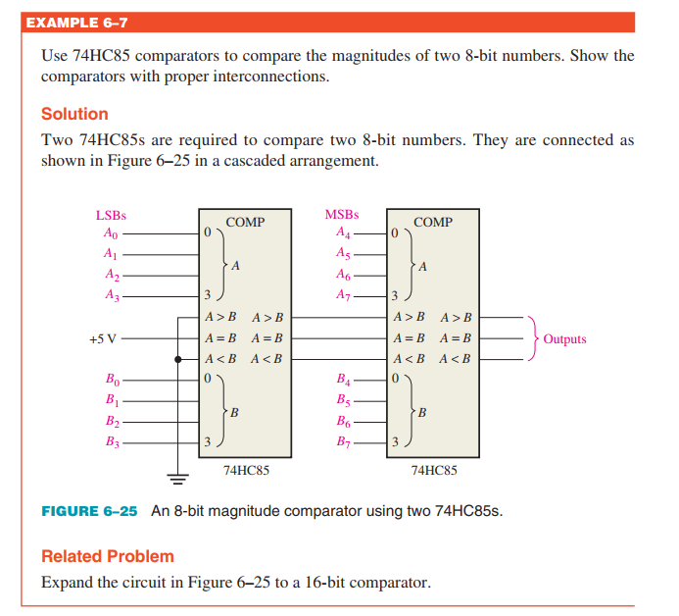
Cascading of Comparator

Slide 58
MUX & DMUX

Slide 59
Multiplexer (MUX)
Many to One

Slide 60
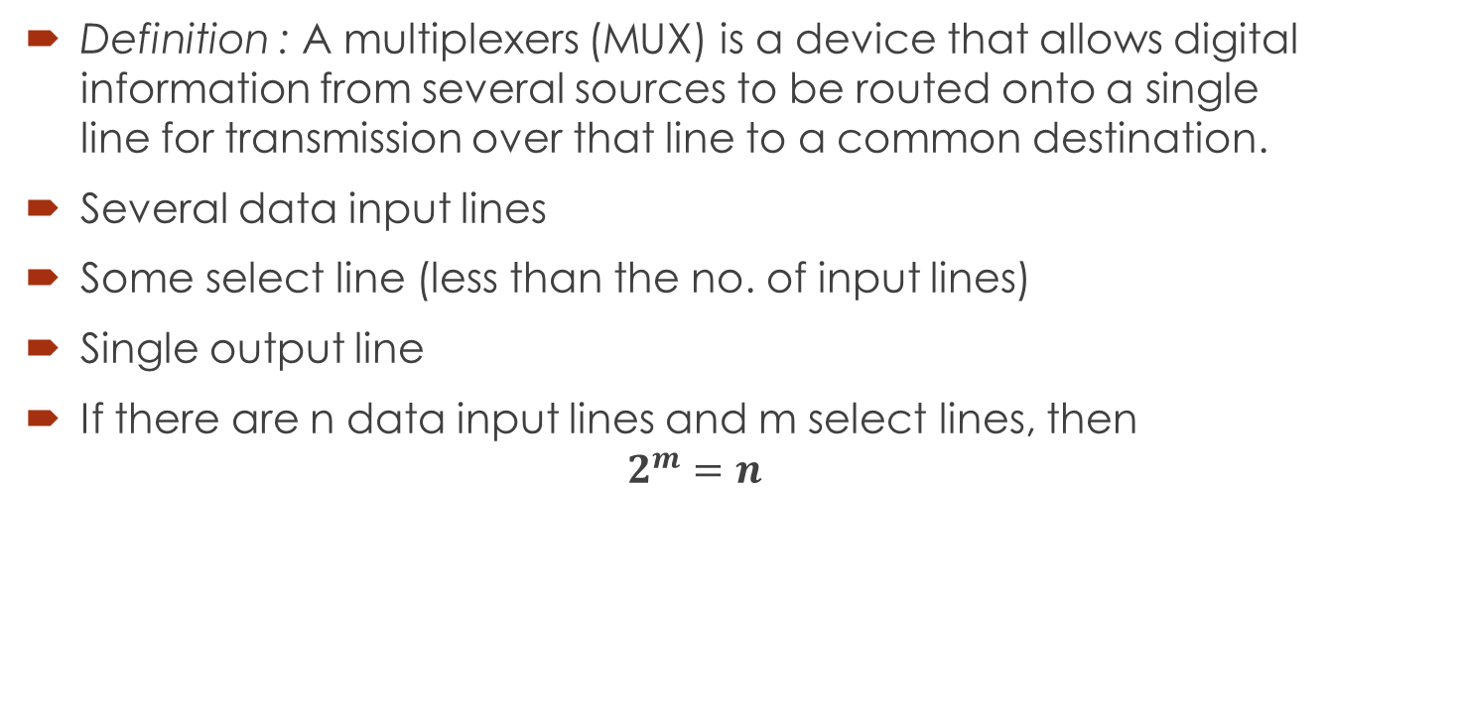
Multiplexer (data Selectors)
Definition : A multiplexers (MUX) is a device that allows digital information from several sources to be routed onto a single line for transmission over that line to a common destination.
Several data input lines
Some select line (less than the no. of input lines)
Single output line
If there are n data input lines and m select lines, then $2^{m}=n$

Slide 61
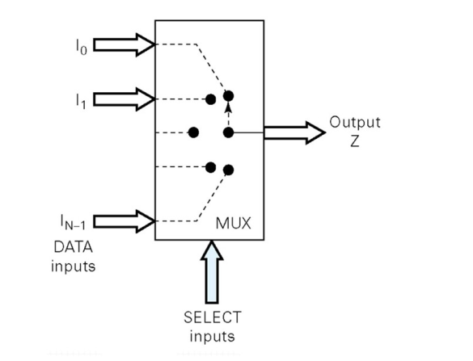
Functional Diagram Of a Multiplexer

Slide 62
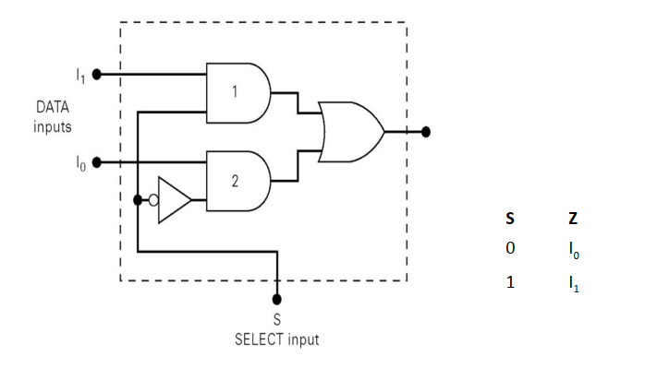
2 : 1 Multiplexer

Slide 63
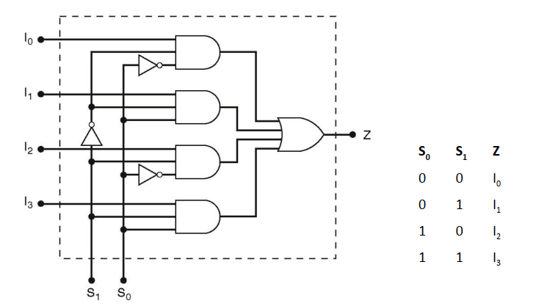
4 : 1 Multiplexer

Slide 64
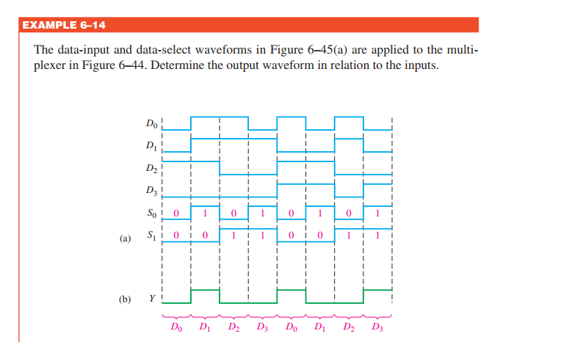
4:1 MUX Timing Diagram

Slide 65
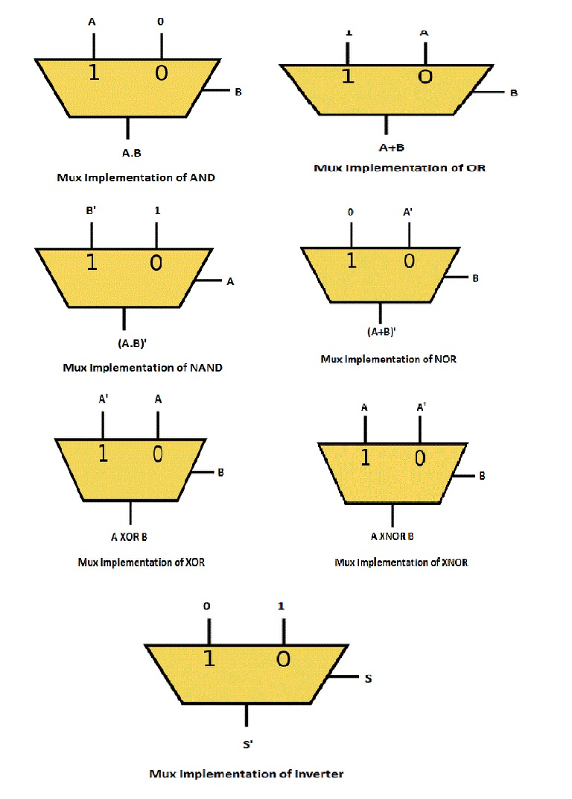
Logic Gates Implementation Using MUX

Slide 66
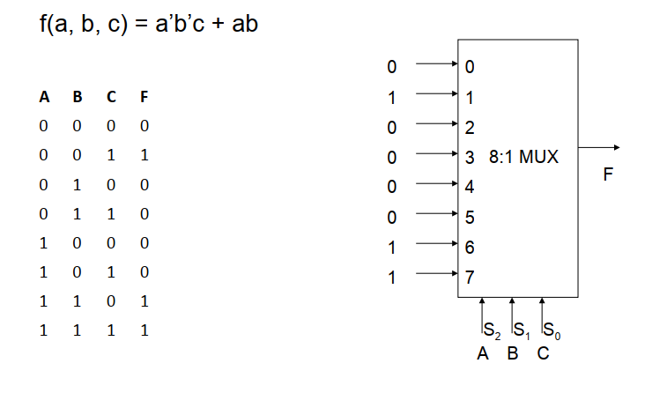
Implementation Of Logic Functions using Multiplexer

Slide 67
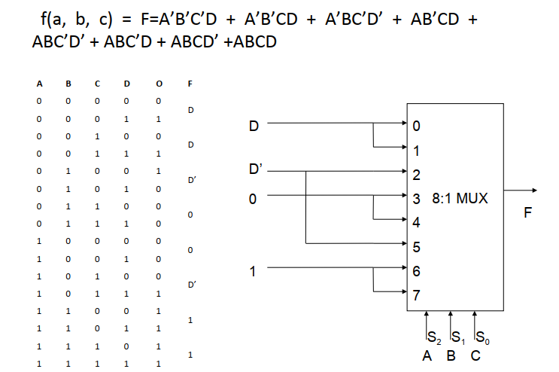

Slide 68
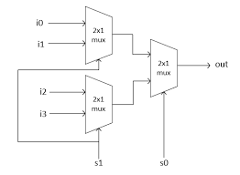
4:1 MUX using 2:1 MUX

Slide 69
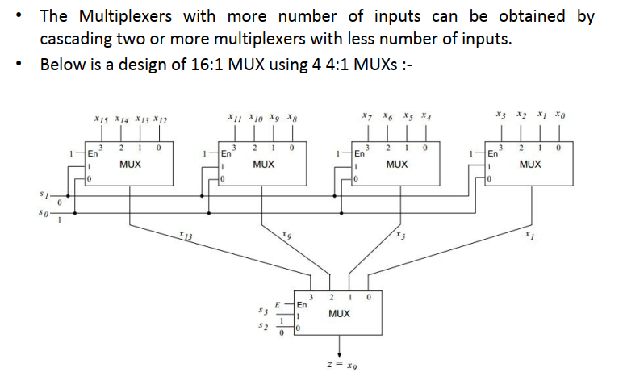
Multiplexer Tree

Slide 70
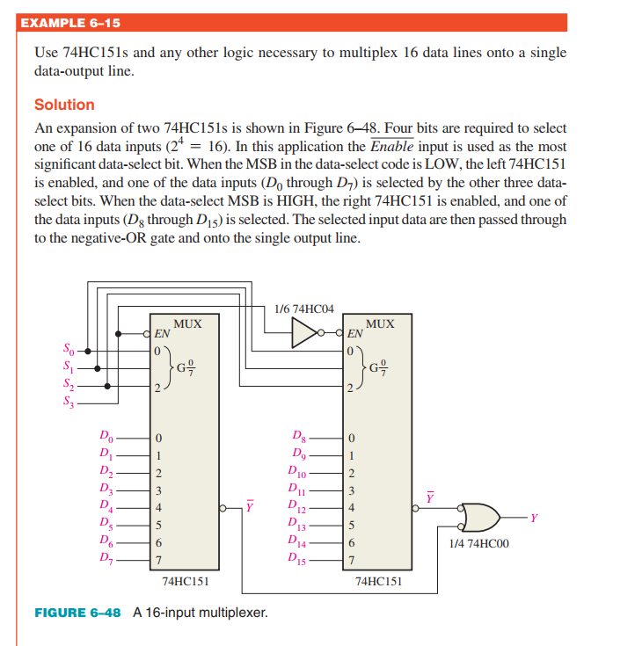
Cascading of MUX

Slide 71
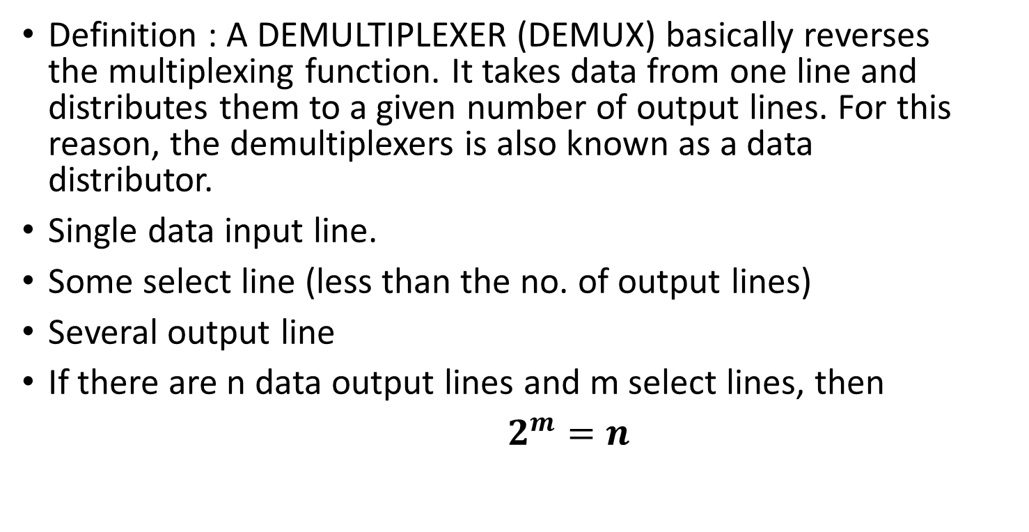
Demultiplexer (Data Distributor)
Definition : A DEMULTIPLEXER (DEMUX) basically reverses the multiplexing function. It takes data from one line and distributes them to a given number of output lines. For this reason, the demultiplexers is also known as a data distributor.
Single data input line.
Some select line (less than the no. of output lines)
Several output line
If there are n data output lines and m select lines, then
$2^{m}=n$

Slide 72
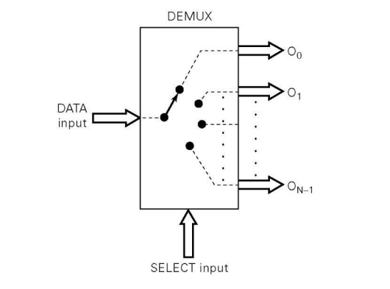
Functional Diagram Of a Demultiplexer

Slide 73

1 : 2 Demultiplexer

Slide 74

1 : 4 Demultiplexer

Slide 75

1:4 DMUX Timing Diagram

Slide 76
DECODERS

Slide 77
Definition
An important part of the system which selects the cells to be read from and written into is the decoder.
– Accepts a value and decodes it
• Output corresponds to value of n inputs
• It also is called many-to-one decoder, a decoder matrix or simply a decoder.

Slide 78



Slide 79

A decoder consists of

Slide 80


Slide 81


Slide 82

What a decoder does

Slide 83

How can you build a 2-to-4 decoder?

Slide 84

A picture of a 2-to-4 decoder

Slide 85

Enable inputs

Slide 86


Slide 87



Slide 88


Slide 89



Slide 90
BCD (Binary Coded Decimal)
Binary coded decimal (BCD) is a system of writing numerals that assigns a four-digit binary code to each digit 0 through 9 in a decimal (base-10) numeral.
The four-bit BCD code for any particular single base-10 digit is its representation in binary notation.
4bit can make 16 combination but in BCD we only uses start 10 combinations.

Slide 91


Slide 92


Slide 93



Slide 94


Slide 95

BCD-Decimal Decoder Waveform

Slide 96


Slide 97

Common Anode (CA)

Slide 98

Common Cathode (CC)

Slide 99


Slide 100


Slide 101


Slide 102


Slide 103


Slide 104


Slide 105
ENCODERS

Slide 106

Encoders

Slide 107


Slide 108



Slide 109



Slide 110


Slide 111


Slide 112


Slide 113

Code Converters

Slide 114


Slide 115


Slide 116


Slide 117


